Slide 1
EAS2655 – Week 3
Agenda
Reading: section 1.2
Hypothesis testing
5 steps
Student’s t-distribution
Parametric vs non-parametric statistics
Type I versus II errors

Slide 2
What is a hypothesis?
A hypothesis is an assumption, an idea that is proposed for the sake of argument so that it can be tested to see if it might be true

Slide 3
What is a hypothesis?
Null Hypothesis

Slide 4
What is a hypothesis?
Null Hypothesis states that there is no meaningful relationship. It is usually the opposite of what you want to demonstrate.

Slide 5
What is a hypothesis?
Null Hypothesis states that there is no meaningful relationship. It is usually the opposite of what you want to demonstrate.
Alternative hypothesis is the opposite of null hypothesis. This is what you want to demonstrate.
If data can reject the null hypothesis, you accept the alternative.

Slide 6
What is a hypothesis?
Examples
New drug vs. placebo
Growth of plants: mineral water vs. distilled water
Climate change and fishery production: does a warmer SST increase the global fish production?
Can you come up with one?

Slide 7
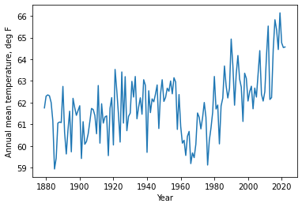
Application to Atlanta’s temperature data
Temperature of Atlanta appears to be warming up.
Is the last ~10 years significantly warmer than the long-term mean?

Slide 8
Application to Atlanta’s temperature data
The 5 steps
State your confidence level
State your null hypothesis and its alternative
State the statistics used
Determine the critical region
Evaluate whether the data is within or outside of the critical region

Slide 9
1. State your confidence level
It is important to set your confidence level first. This sets how extreme the data should be in order to reject the null hypothesis.
Example
95% confidence level means we reject null hypothesis if data is extreme beyond 95% of expected range.

Slide 10
2. State the null hypothesis and its alternative
Example
H₀: Mean temperature from the last 10 years is NOT significantly warmer than the long-term mean.
H₁: Mean temperature from the last 10 years is significantly warmer than the long-term mean.

Slide 11
3. State the statistics used.
Example
We use Student’s t-distribution with one-tailed test.
What is Student’s t-distribution?
What is one-tailed test?

Slide 12
Student’s t-distribution
In probability and statistics, Student's t-distribution (or simply the t-distribution) is any member of a family of continuous probability distributions that arise when estimating the mean of a normally distributed population in situations where the sample size is small and the population's standard deviation is unknown.
The t-distribution is symmetric and bell-shaped, like the normal distribution. However, the t-distribution has heavier tails, meaning that it is more prone to producing values that fall far from its mean.

Slide 13
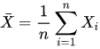
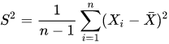
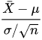
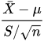
Let X₁ , … , X_{n} be independently and identically drawn from the distribution N(μ, 𝝈), i.e. this is a sample of size n from a normally distributed population with expected mean value μ and variance 𝝈².
Let
Be the sample mean and let
Be the sample variance. Then the random variable
has a standard normal distribution (i.e., N(0, 1))
and the random variable
i.e where S has been substituted for 𝝈, has a Student's t- distribution with n-1 degrees of freedom

Slide 14
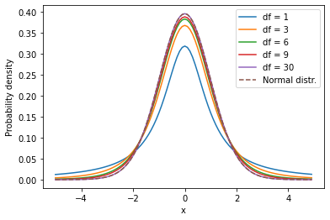
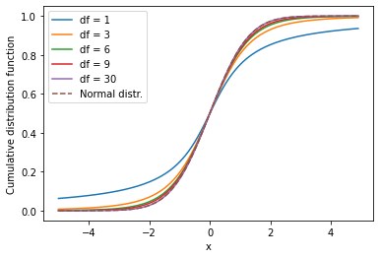
Student’s t-distribution
(vs. normal distribution)
See Week3_exercise code (part 1) to reproduce these plots

Slide 15
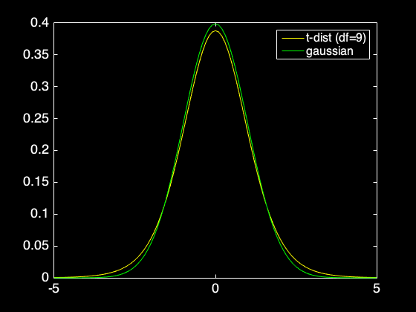
Student’s t-distribution

Slide 16

Student’s t-distribution?
Z-transformation (standardization)
$$z=\frac{x−\overline{x}}{σ}$$

Slide 17
Student’s t-distribution?
To define t-distribution, we need the degree of freedom
What is degree of freedom (d.f.)?
d.f. measures the number of independent information and is set to N-1
In this example, N=10 so d.f. is 9.
t-distribution is similar to Gaussian but its shape is slightly flatter, and it approaches Gaussian as d.f. increases

Slide 18
Student’s t-distribution
CLT states that sample mean M follows Gaussian for sufficiently large N.
Usually, N>30 meets this condition.
If your sample size is small (N<30) you need to use t-distribution, not Gaussian.

Slide 19
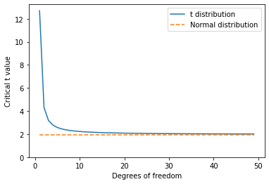
Student’s t-distribution
x values at 97.5 percentile for varied degrees of freedom

Slide 20
One-tailed test
We have two options. One-tailed or two-tailed tests. It affects how we calculate the critical region.

Slide 21
One-tailed test
We have two options. One-tailed or two-tailed tests. It affects how we calculate the critical region.
In this particular example, we choose one-tailed test because we already know the last 10 year is warmer (not colder).

Slide 22
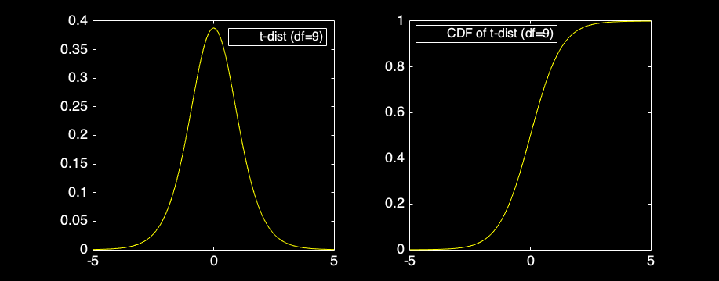
4. Determine the critical region
Critical region is related to the percentile value.
For one-tail test, the critical region with the 95% confidence level is 95% percentile value

Slide 23
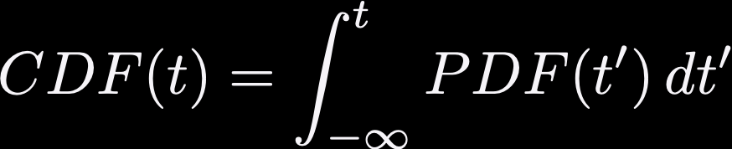
Calculating the critical region

Slide 24

Calculating the critical region
Critical region is related to the percentile value.
For one-tail test, the critical region with the 95% confidence level is 95% percentile value
Look for the t-value at 0.95 = CDF(t,d.f.=9) where CDF is the cumulative distribution function.
This can be done using the inverse CDF

Slide 25
Calculating the critical region
This is a one-tailed test (for two-tailed test, use 97.5 percentile OR α/2 instead of α itself)
In this case (df = 9), the critical t-value is 1.8 with α value of 0.05

Slide 26

5. Evaluate whether data is within the critical region
Calculate the t-value of the data:
x: Mean temperature from the last 10 years
μ: Long term mean temperature
t-value is (signal)/(standard error)

Slide 27
5. Evaluate whether data is within the critical region
x = 64.2°F (from last 10 years)
μ = 61.9°F (long-term mean)
s = 1.5 °F (standard deviation of last 10 years)
t-value is 4.8, which is much larger than the critical value of 1.8.

Slide 28
5. Evaluate whether data is within the critical region
If the null hypothesis is correct, the t-value will be t<t_{crit} for the confidence level (95%)
t>t_{crit}: we reject the null hypothesis
Random sampling cannot explain the warm temperature from the last 10 years!
(p-value) What’s the probability of getting the observed signal by random sampling: p=1-CDF(tvalue,df) p=0.0005 (0.05%).

Slide 29
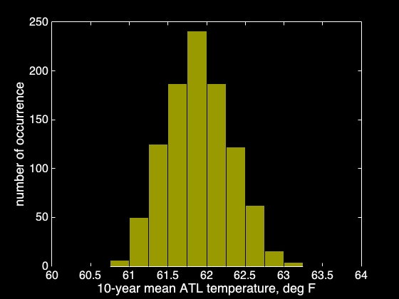
Parametric vs Non-parametric statistics
Bootstrap method:
N=10-year random sampling
Repeated K=1000 times
This is a non-parametric statistics. We did not make assumptions about the distribution of 10-year mean data.

Slide 30
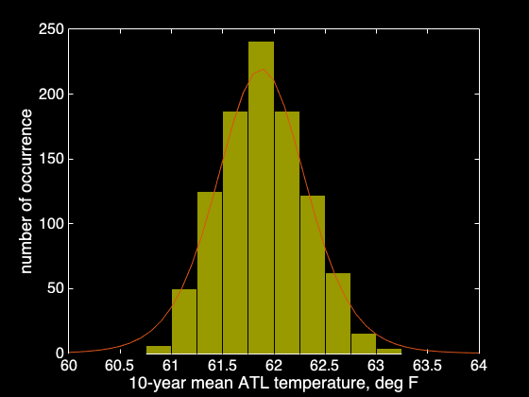
Parametric vs Non-parametric statistics
t-test
Uses Student’s t-distribution.
This is a parametric statistics. We assumed that the distribution of 10-year mean data follows a known distribution.

Slide 31
Type I vs II errors
There are 4 possible outcomes of the hypothesis testing
1. Null hypothesis is NOT true, and the t-test rejects the null hypothesis (true positive)
2. Null hypothesis is true, and the t-test does not reject the null hypothesis (true negative)
3. Null hypothesis is true, and the the t-test rejects the null hypothesis (false positive = Type I error)
4. Null hypothesis is NOT true, and the t-test does not reject the null hypothesis (false negative = Type II error)

Slide 32
Type I error
False positive
Random sampling can sometimes create a strong signal.
If confidence level is 95%, this happens at 5% probability (the “α” value is the probability of committing Type I error)
To reduce the Type I error, increase the confidence level (i.e. lower the α value). Higher level of confidence requires a stronger t-value in order to reject H₀.

Slide 33
Type II error
False negative
The signal is not very strong and/or sample size is small.
If the confidence level is very high, type II error can occur.
To reduce the Type II error while keeping certain confidence level, it is necessary to collect more data. You should not just lower the confidence level to get the result you want.

Slide 34
Useful MATLAB functions
tpdf(X,df) returns the values of t-distribution at X with a given degree of freedom (df)
tcdf(X,df) returns the values of cumulative distribution functions at X with a given df: Useful for calculating p-value
tinv(1-α,df) returns the critical t-value for a given α and df

Slide 35
Useful Python functions
We will use stats library from scipy included in anaconda
from scipy import stats
stats.t.pdf(X,df) returns the values of t-distribution at X with a given degree of freedom (df)
stats.t.cdf(X,df) returns the values of cumulative distribution functions at X with a given df: Useful for calculating p-value
stats.t.ppf(1-α,df) returns the critical t-value for a given α and df

Slide 36



Comparing samples statistics
Assume you want to compare 2 groups of samples

Slide 37
Comparing 2 sample statistics
Assume you want to compare 2 groups of samples
Is 2010s warmer than 1990s in Atlanta?
Is the climate of Atlanta and Athens different?
Are the two instruments (satellite, ocean prove, air pollution data, two different analysis methods etc) measuring the same signal?
Wide applications: two types of drugs, two weight loss programs, two types of xyz…

Slide 38
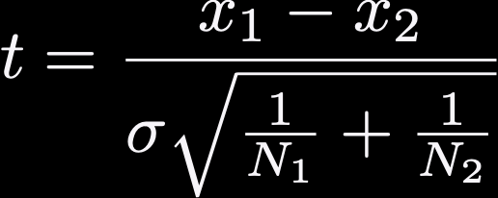
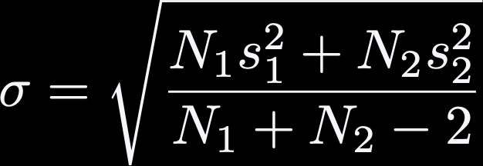
Comparing sample statistics
Assume you want to compare 2 groups of samples
Sample size N₁ and N₂, means x₁ and x₂, standard deviation s₁ and s₂
Null hypothesis: the two samples are coming from the same population (x₁ = x₂)

Slide 39
Confidence Interval
You don’t know the true mean value. However, you can take multiple, independent samples and make a statistical statement.
Example: N measurements with mean M and standard deviation S.
What is the 95% confidence interval on true mean (μ)?

Slide 40
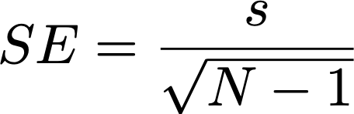

Confidence Interval
Calculate the SE
Calculate the degree of freedom (df = N-1)
Calculate the critical region: you can use Gaussian if N > 30, otherwise use the t-distribution. For 95% CI, it would be 97.5 percentile t-value (assuming two-tailed).

